Slide 1
Price & Wage Rigidity- Voluntary and Involuntary Unemployment
Ravi Kiran

Slide 2
Price & Wage Rigidity
In macroeconomics, rigidities are real prices and wages that fail to adjust to the level indicated by equilibrium or if something holds one price or wage fixed to a relative value of another.
In the classical model, unemployment is due to mismatches between workers and firms.
Keynesians are skeptical, believing that recessions lead to substantial cyclical employment.
To get a model in which unemployment persists, Keynesian theory posits that the real wage is slow to adjust to equilibrate the labor market

Slide 3
Sticky wage theory
The sticky wage theory hypothesizes that pay of employees tends to have a slow response to the changes in the performance of a company or the economy.
According to the theory, when unemployment rises, the wages of those workers that remain employed tend to stay the same or grow at a slower rate than before rather than falling with the decrease in demand for labor.
Specifically, wages are often said to be sticky-down, meaning that they can move up easily but move down only with difficulty.

Slide 4
Sticky wage theory
Stickiness is a theorized condition in the market and can apply to more areas than wages alone.
Stickiness is a condition wherein a nominal price resists change.
While it can often apply to wages, stickiness may also often be used in reference to prices within a market, which is also often called price stickiness.
Prices, however, are generally thought of as not being as sticky as wages are, as the prices of goods often change easily and frequently in response to changes in supply and demand.

Slide 5
Sticky wage theory
The aggregate price level, or average level of prices within a market, can become sticky due to a mixture of rigidity and flexibility in pricing.
This means that price levels will not respond to large shifts in the economy as quickly as they otherwise would.
Wages are often said to work in the same way: some are sticky, causing aggregate wage levels to become sticky as well.

Slide 6
Sticky wage theory
Proponents of the theory have posed a number of reasons as to why wages are sticky.
These include:
workers are much more willing to accept pay raises than cuts,
some workers are union members with long-term contracts
a company may not want to expose itself to the bad press associated with wage cuts.

Slide 7
Sticky Wage Theory and Sticky Employment
Employment rates are also affected by the distortions in the job market produced by sticky wages.
For example, in the event of a recession, like the Great Recession of 2008, nominal wages didn't decrease, due to the stickiness of wages.
Instead, companies laid-off employees to cut costs without reducing wages paid to the remaining employees.
Later, as the economy began to come out of recession, both wages and employment will remain sticky.

Slide 8
Sticky Wage Theory and Sticky Employment
Because it can be challenging to determine when a recession is ending, in addition to the fact that hiring new employees may often represent a higher short-term cost than a slight raise to wages, companies will often be hesitant to begin hiring new employees.
In this respect, in the wake of recession, employment may often be “sticky-up.”
On the other hand, according to the theory, wages will often remain sticky-down, and employees who made it through may see raises in pay.

Slide 9
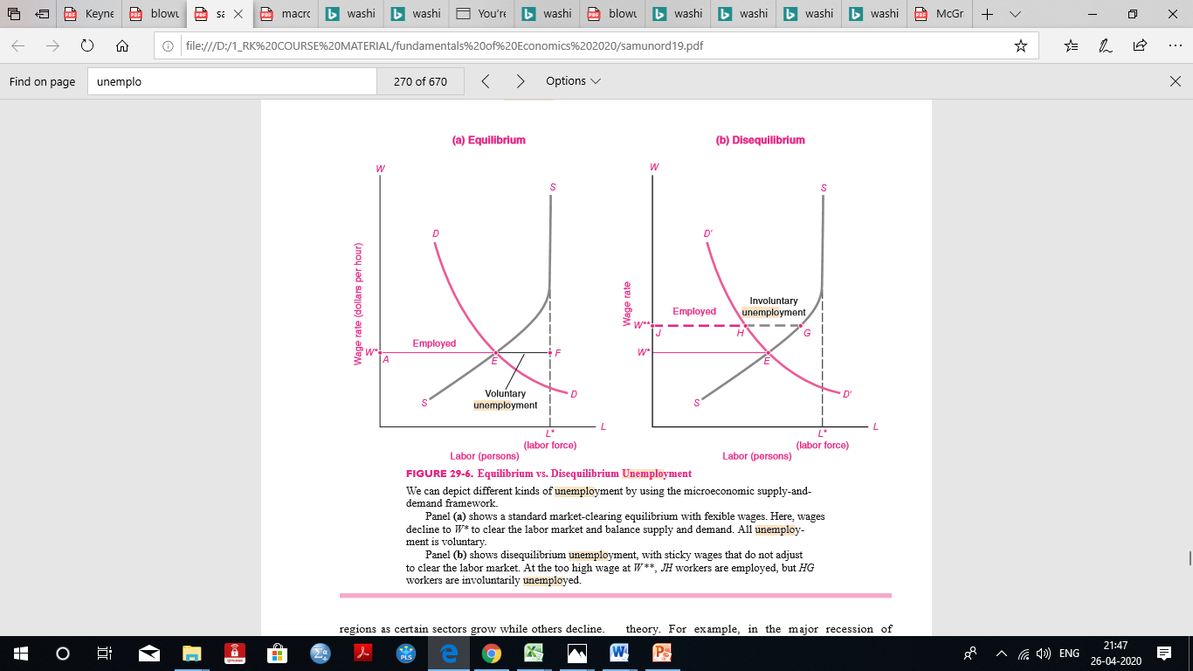

Slide 10
Voluntary Unemployment
Equilibrium unemployment arises when people become unemployed voluntarily as they move from job to job or into and out of the labor force.
This is also sometimes called frictional unemployment because people cannot move instantaneously between jobs.
Someone working at the local hamburger stand might decide that the pay is too low, or the hours are too inconvenient, and quit to look for a better job.
Others might decide to take time off between school and their first job.

Slide 11
Voluntary Unemployment
This kind of unemployment is equilibrium unemployment because firms and workers are on their supply and demand schedules.
The market is clearing properly in the sense that all workers who desire jobs at the going wages and working conditions have them and all firms that wish to hire workers at the going compensation can find them.
Some economists label this voluntary unemployment to denote that people are unemployed because they prefer that state over other labor market states

Slide 12
Disequilibrium unemployment
Disequilibrium unemployment occurs when the labor market or the macro -economy is not functioning properly and some qualified people who are willing to work at the going wage cannot find jobs.
Two examples of disequilibrium are:
structural unemployment
cyclical unemployment

Slide 13
Structural unemployment
Structural unemployment signifies a mismatch between the supply of and the demand for workers.
Mismatches can occur because the demand for one kind of labor is rising while the demand for another kind is falling and markets do not quickly adjust.
We often see structural imbalances across occupations or regions as certain sectors grow while others decline.

Slide 14
Cyclical unemployment
Cyclical unemployment exists when the overall demand for labor declines in business-cycle downturns.
For example, in the major recession of 2007–2009, the demand for labor declined and unemployment rose in virtually every industry and region.
In the long expansion of the 2000s, the unemployment rate fell in virtually every state in the United States.
The labor market consequences of business cycles differ from case to case, from mild declines in employment growth to job losses totaling a sizable fraction of the population.

Slide 15
Wages are sticky in the short run at the initial level of W**.
When there is a decline in the demand for labor, and labor demand declines to the D’D’ curve in (b), the market wage is W** Itis above the market clearing wage at W*.
At the too high wage rate, there are more qualified workers looking for work than there are vacancies looking for workers.
The number of workers desiring to work at wage W ** is at point G on the supply curve, but firms want to hire only H workers, as shown by the demand curve.

Slide 16
Because the wage exceeds the market-clearing level, there is a surplus of workers.
The unemployed workers represented by the dashed line segment HG constitute disequilibrium unemployment.
Alternatively, we may call them “involuntarily unemployed,” signifying that they are qualified workers who want to work at the prevailing wage but cannot find jobs.

Slide 17
Involuntarily Unemployment
For example, an acute shortage of nurses arose recently as the number of skilled nurses grew slowly while the demand for nursing care grew rapidly because of an aging population.
Not until nurses’ salaries rose rapidly and the supply adjusted did the structural shortage of nurses decline.
By contrast, the demand for coal miners has been depressed for decades because of the lack of geographic mobility of labor and capital; unemployment rates in coalmining communities remain high today.

Slide 18

THANKS

